Slide 1





Nucleation Benchmark Problem
Wenkun Wu^{a,d}, David Taboada^{b}, Jonathan Guyer^{c}, Olle Heinonen^{d,e}, James Warren^{c}, Peter Voorhees^{a,f}, Daniel Wheeler^{c}, László Gránásy^{g} and Tamás Pusztai^{g}
ª Center for Hierarchical Materials Design, Northwestern University, 2205 Tech Drive, Suite, 1160, Evanston, IL, 60208, USA
^{b} Department of Materials Science and Engineering, University of Michigan, 2300 Hayward St., Ann Arbor, MI 48106, USA
^{c} Materials Measurement Laboratory, National Institute of Science and Technology, 100 Bureau Drive, MS8300, Gaithersburg, MD 20900-8300
^{d} Materials Science Division, Argonne National Laboratory, 9700 South Cass Avenue, Lemont, IL, 60439, USA
^{e} Northwestern-Argonne Institute of Science and Engineering, 2205 Tech Drive, Suite 1160, Evanston, IL, 60208, USA
^{f} Department of Material Science and Engineering, Northwestern University, 2220 Campus Drive, Evanston, IL, 60208, USA
^{g} Research Institute for Solid State Physics and Optics, P.O. Box 49, H-1525 Budapest, Hungary

Slide 2
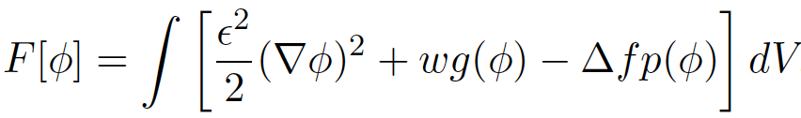
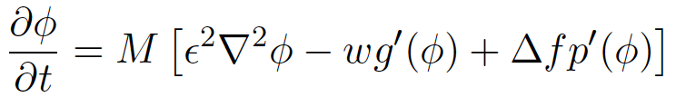
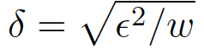
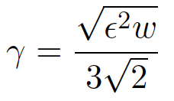
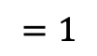
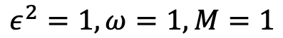
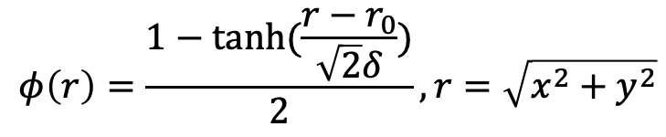
Problem Setup
driving force for solidification
Free energy:
Time evolution of ɸ given by the Allen-Cahn equation:
$$ε^{2}=1, ω=1, M=1$$
$$φ\left(r\right)=\frac{1−tanh⁡(\frac{r−r_{0}}{\sqrt{2}δ})}{2}, r=\sqrt{x^{2}+y^{2}}$$
Initial condition:
Unit length – width of the interface:
$$=1$$
Interfacial energy:
5

Slide 3
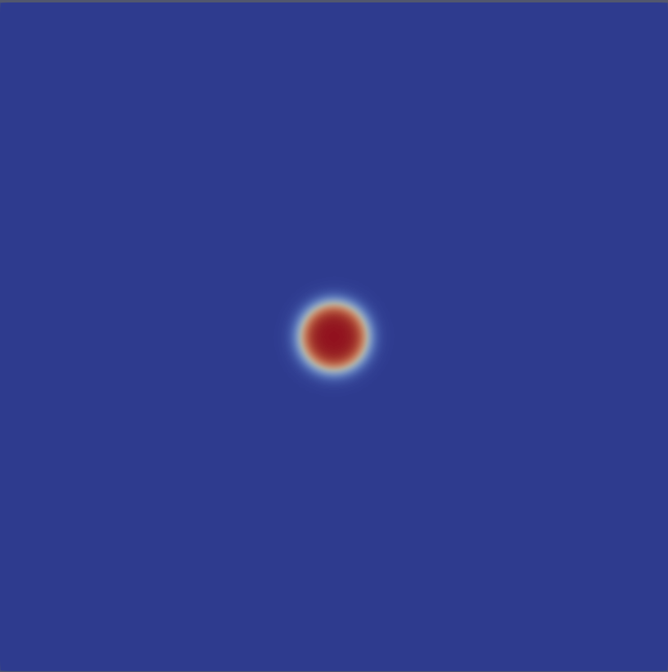
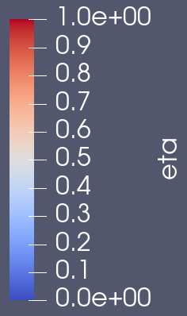
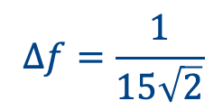
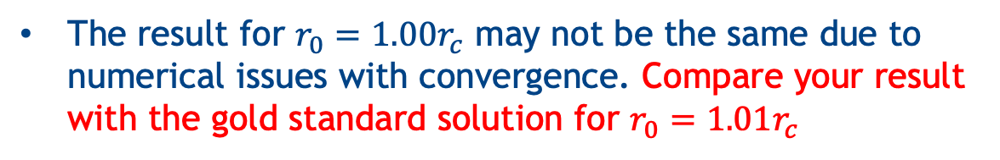
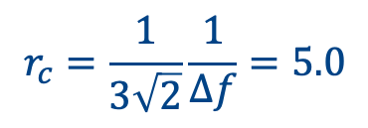
1. Explicit Nucleation: Single Seed
$$∆f=\frac{1}{15\sqrt{2}}$$
$$r_{c}=\frac{1}{3\sqrt{2}}\frac{1}{∆f}=5.0$$
System size: 100 x 100
No-flux boundary condition
Run three simulations with different initial nucleus radius $r_{0}={0.99r}_{c},{1.00r}_{c},{1.01r}_{c}$
t=0
Follow the time evolution of the system for t = 100 units, and plot the solid fraction X and the total free energy F as function of time
The result for $r_{0}={1.00r}_{c}$ may not be the same due to numerical issues with convergence. Compare your result with the gold standard solution for $r_{0}={1.01r}_{c}$
24

Slide 4
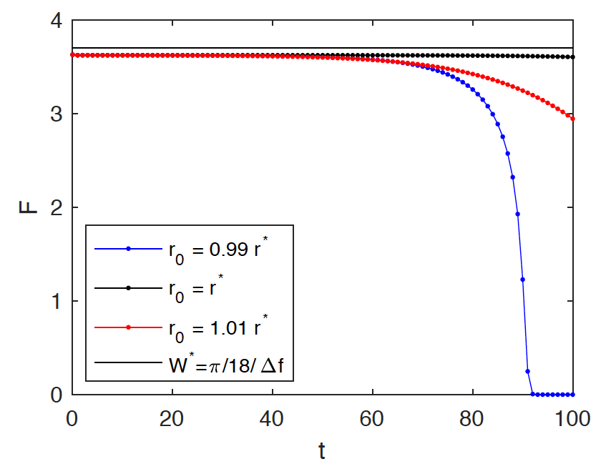
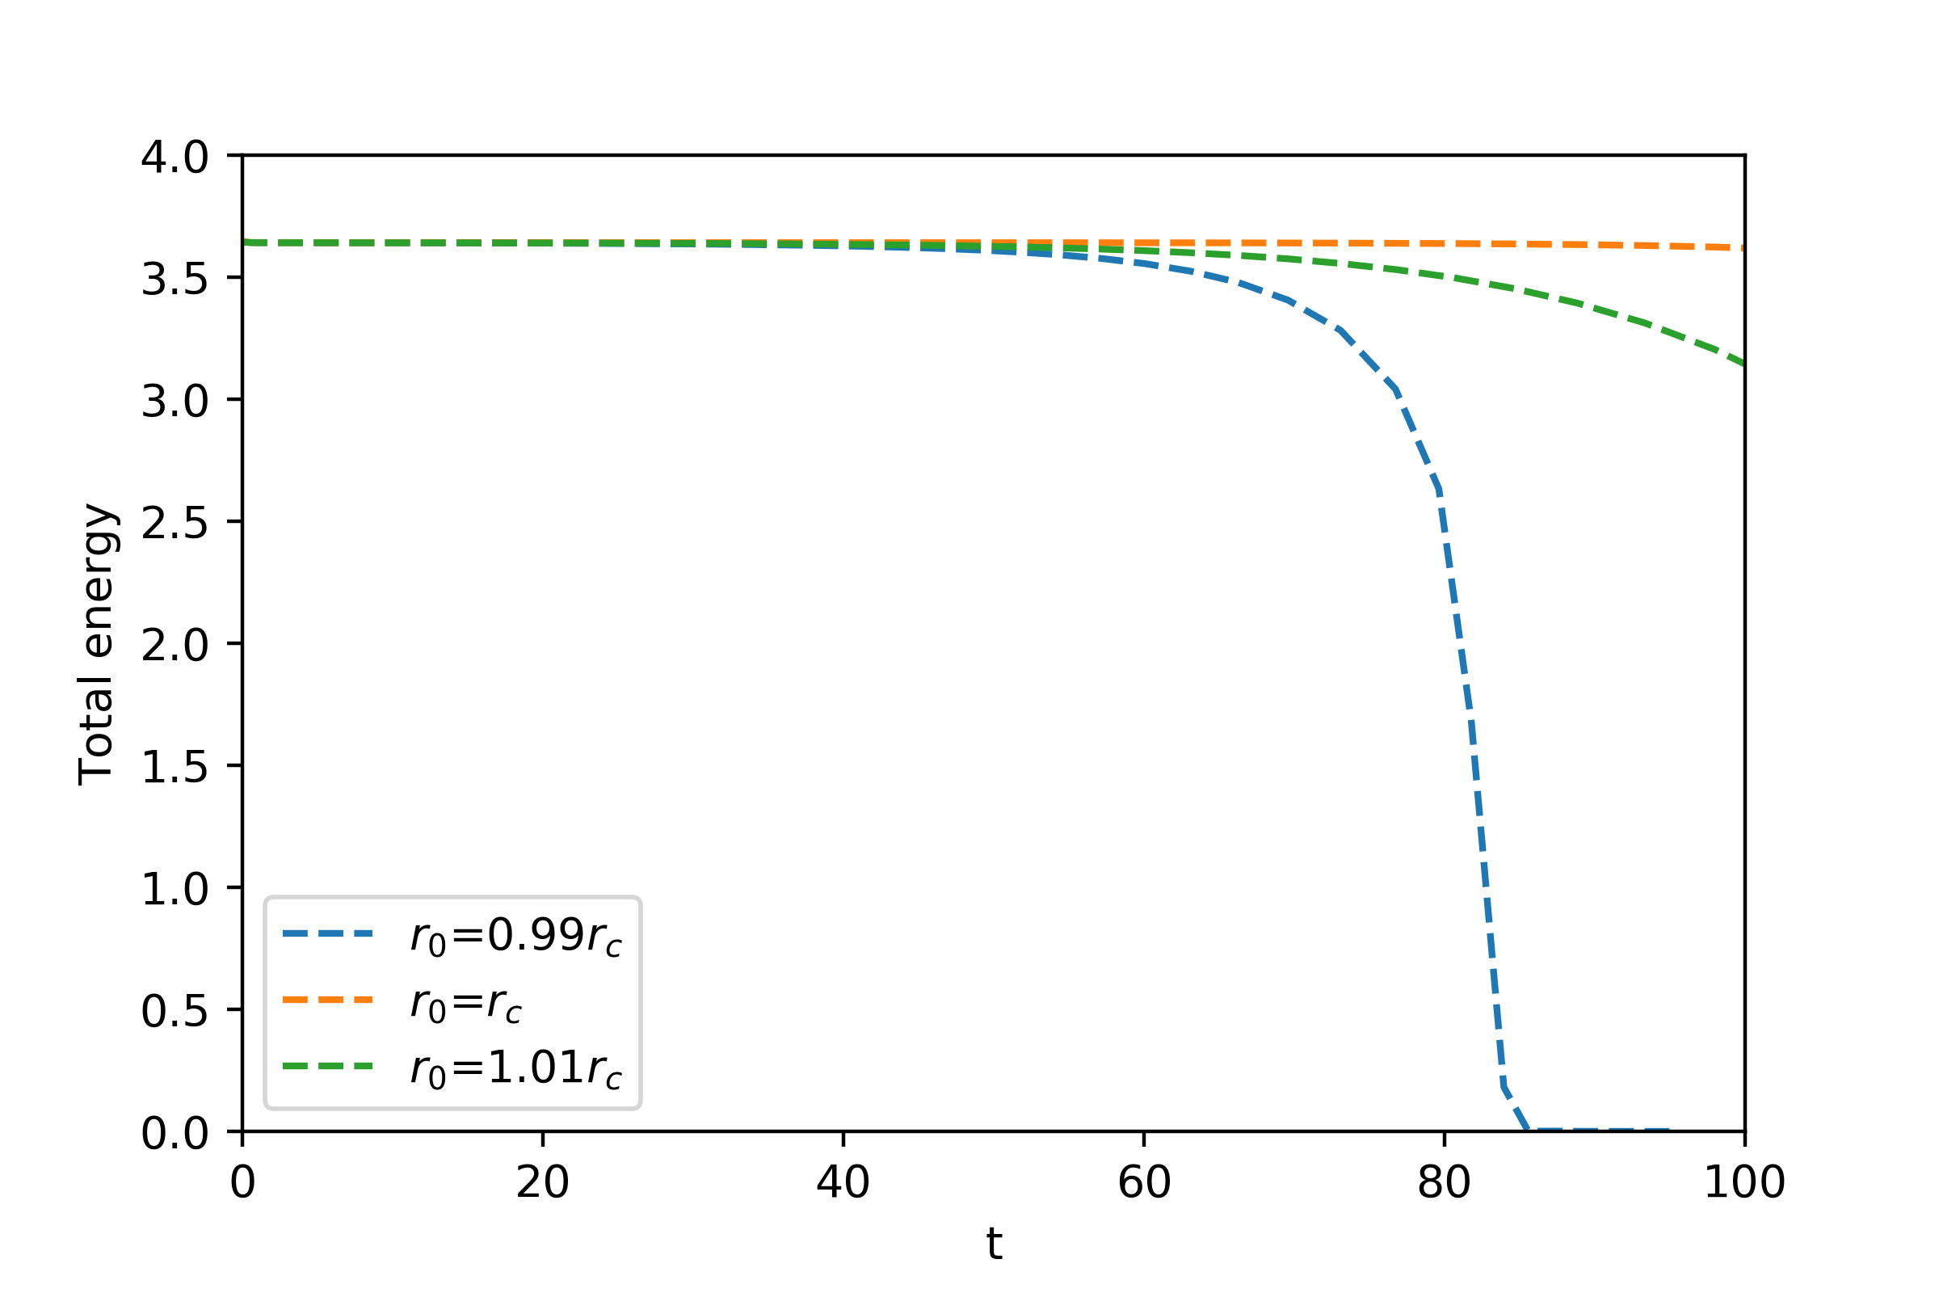
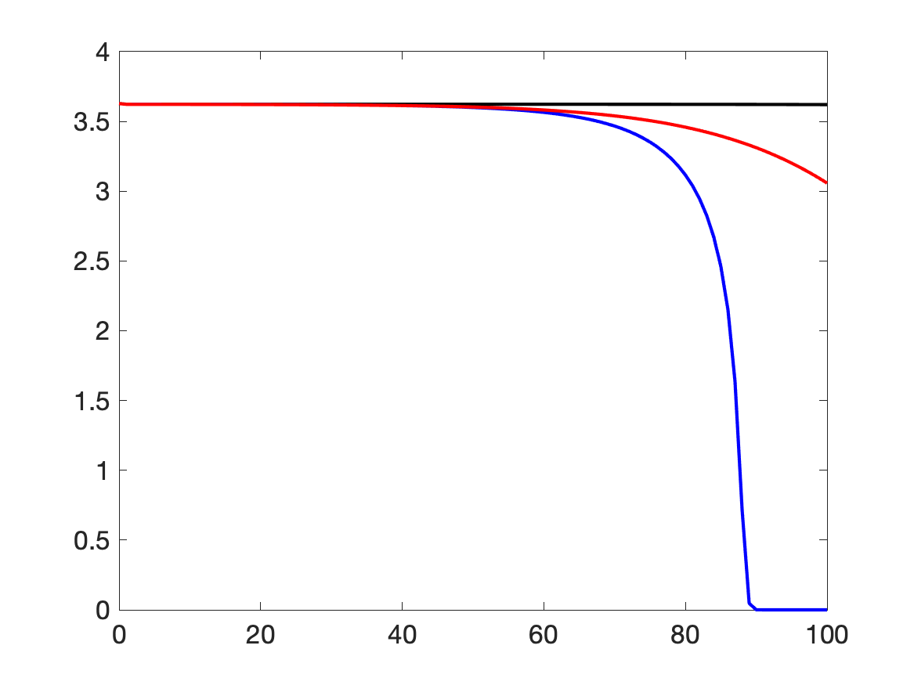
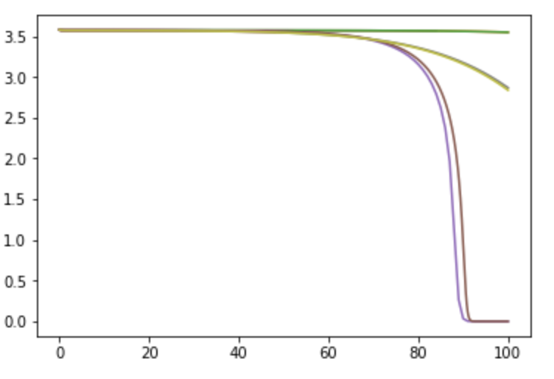
Free Energies
Finite Difference
MOOSE
FiPy
PRISMS-PF
F
7
t

Slide 5
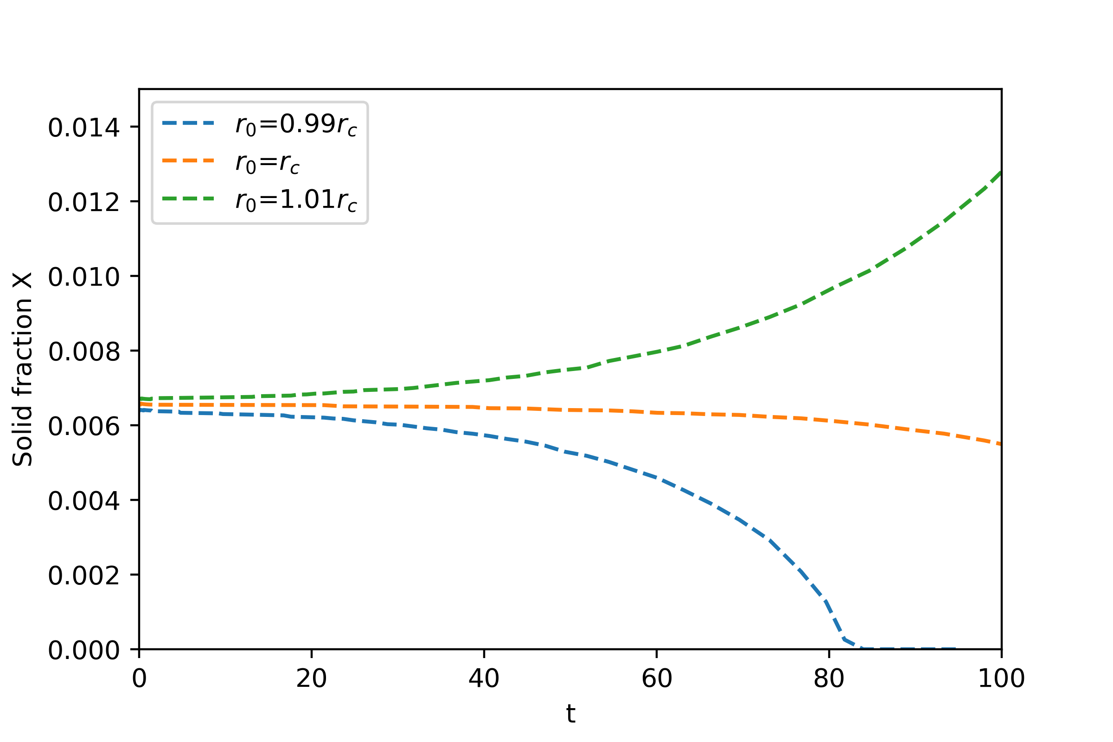
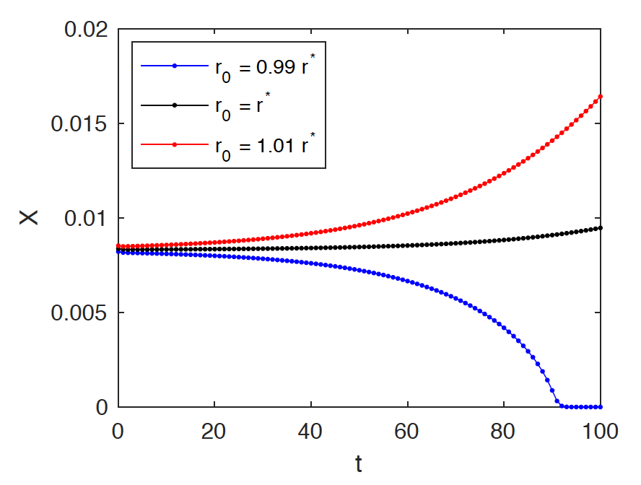
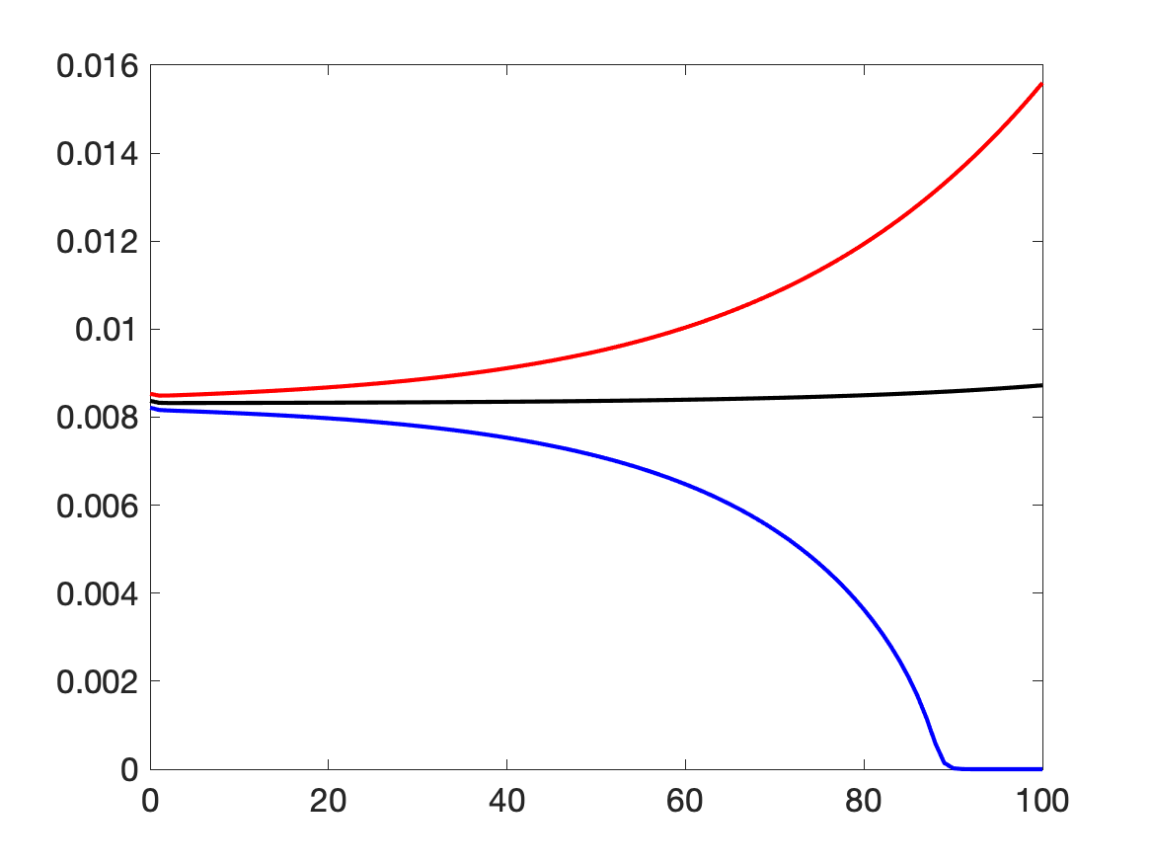
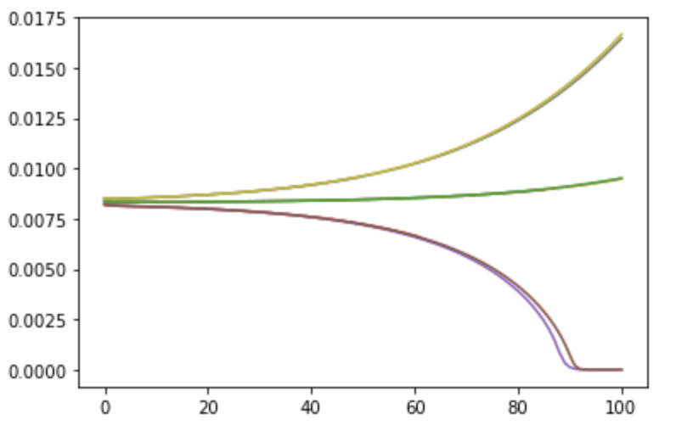
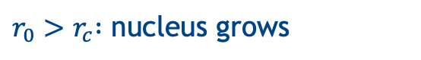
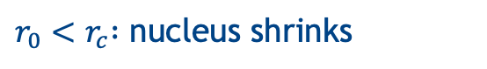
Solid Fraction
Finite Difference
MOOSE
FiPy
X
PRISMS-PF
t
8
$r_{0}{>r}_{c} :$ nucleus grows
$r_{0}{<r}_{c} :$ nucleus shrinks

Slide 6
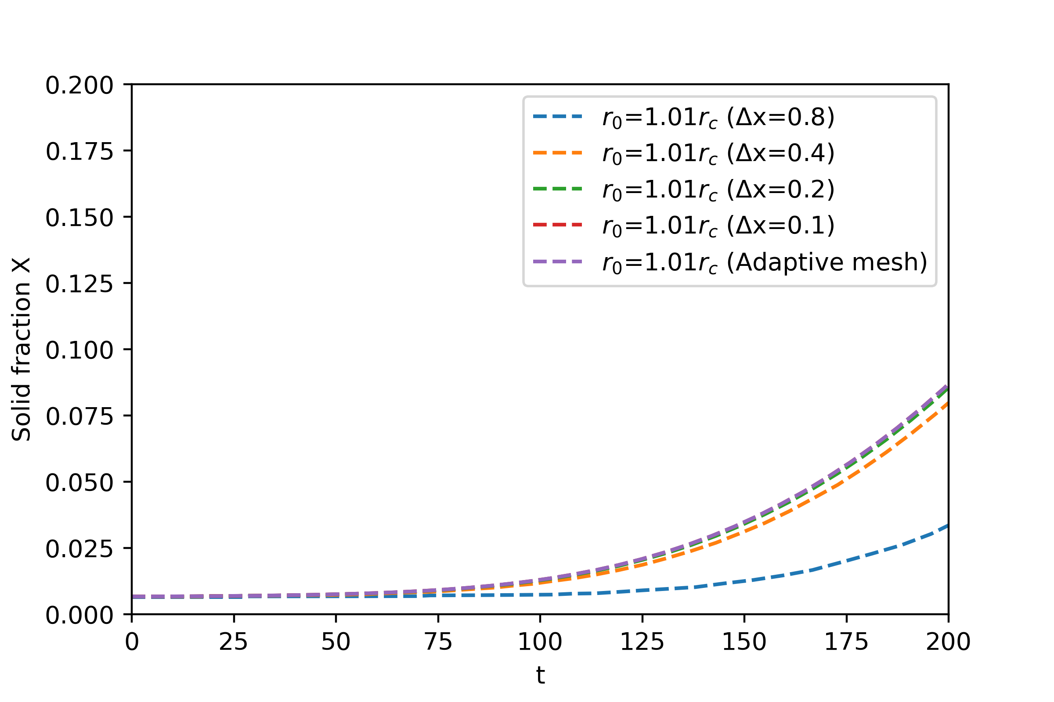
Convergence Test for Single Seed Nucleation
(finest part Δx=0.1)
Gold standard solution
29

Slide 7
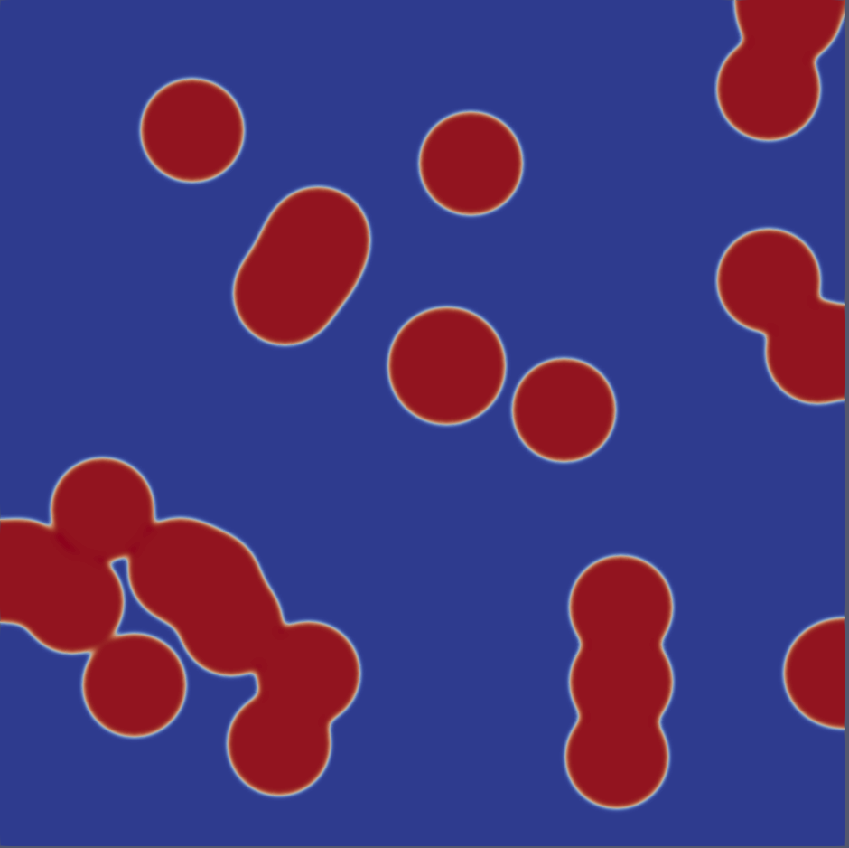
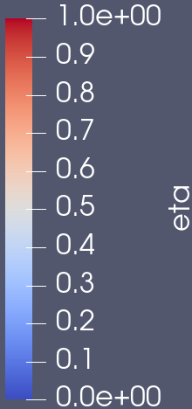
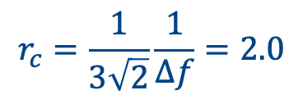
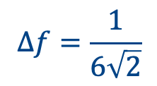
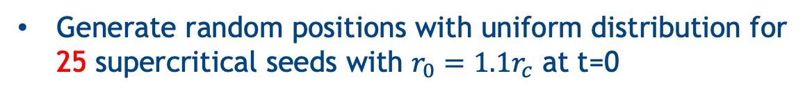
2. Explicit Nucleation: Multiple Seeds at t=0
$$∆f=\frac{1}{6\sqrt{2}}$$
$$r_{c}=\frac{1}{3\sqrt{2}}\frac{1}{∆f}=2.0$$
System size:
500 x 500
No-flux boundary condition
t=80
Generate random positions with uniform distribution for 25 supercritical seeds with $r_{0}={1.1r}_{c}$ at t=0
Run the simulation until t = 300. By this time, the whole domain should be transformed to solid
Plot the time evolution of the total free energy, total number of particles, volume fraction, and make the Avrami plot. The slope of the Avrami plot should be close to n=2
25

Slide 8
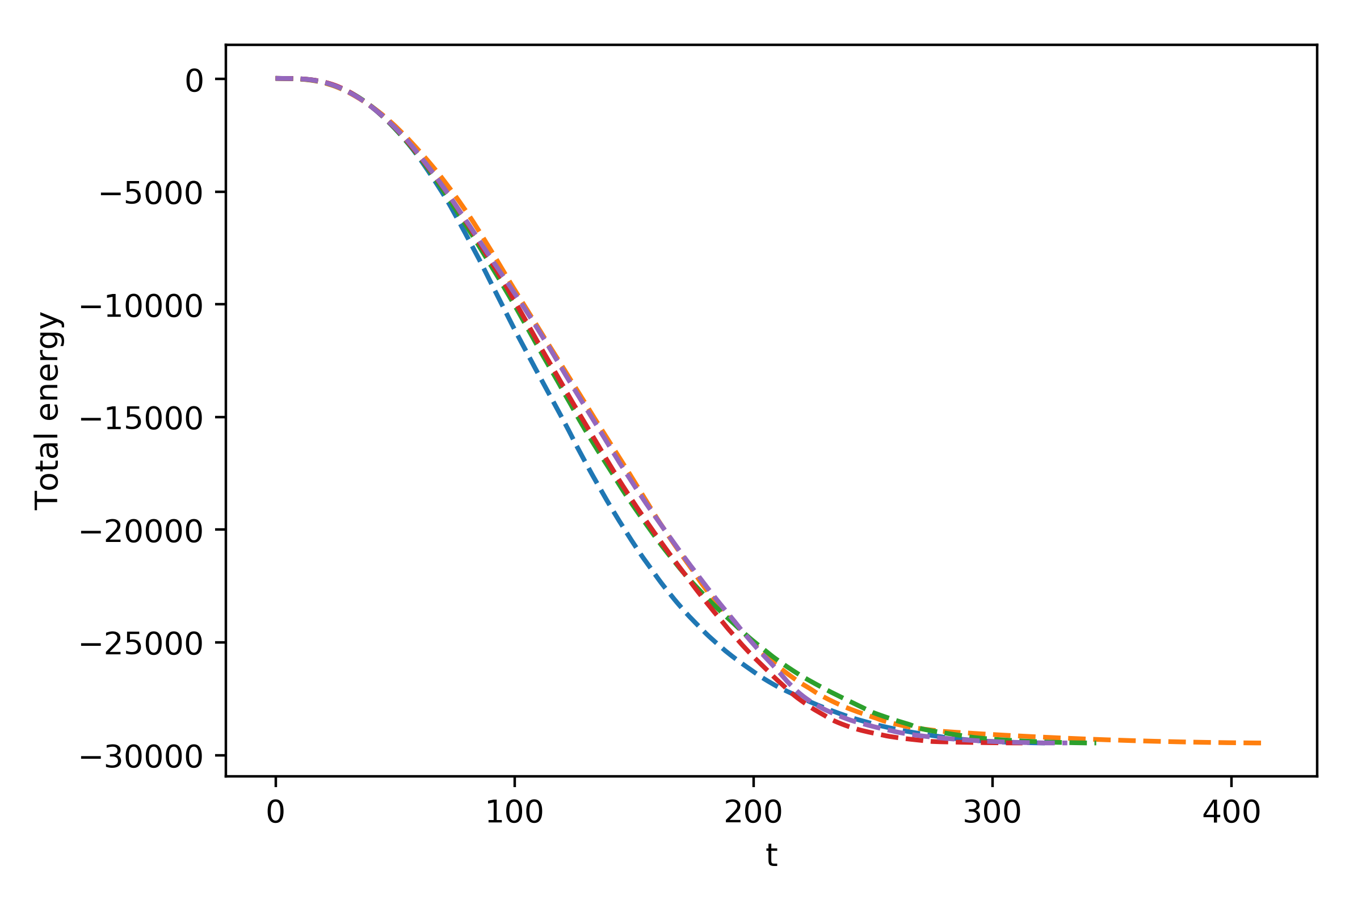
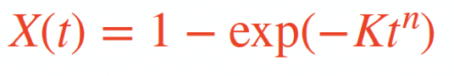
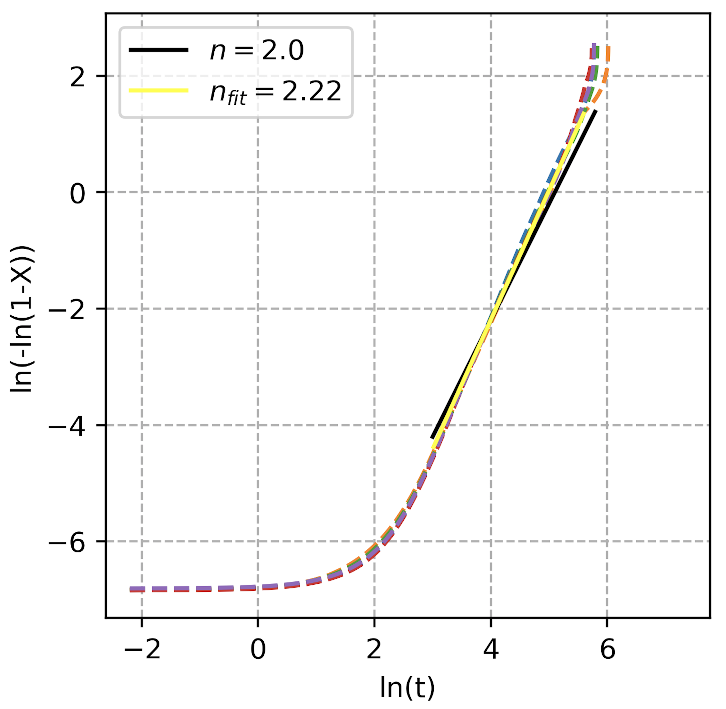
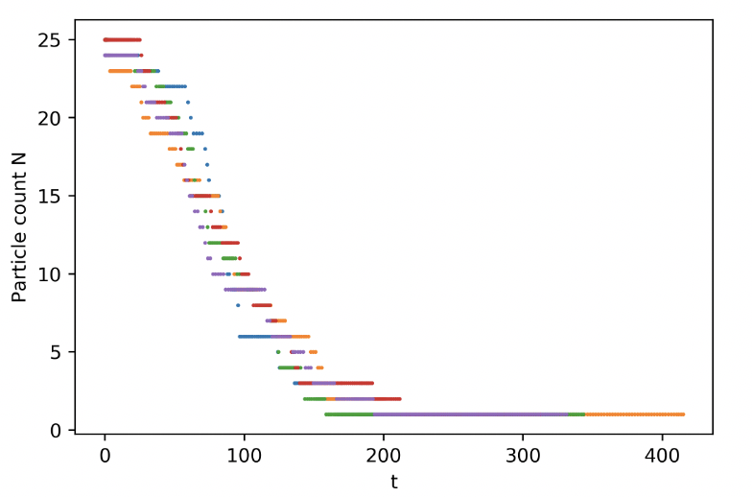
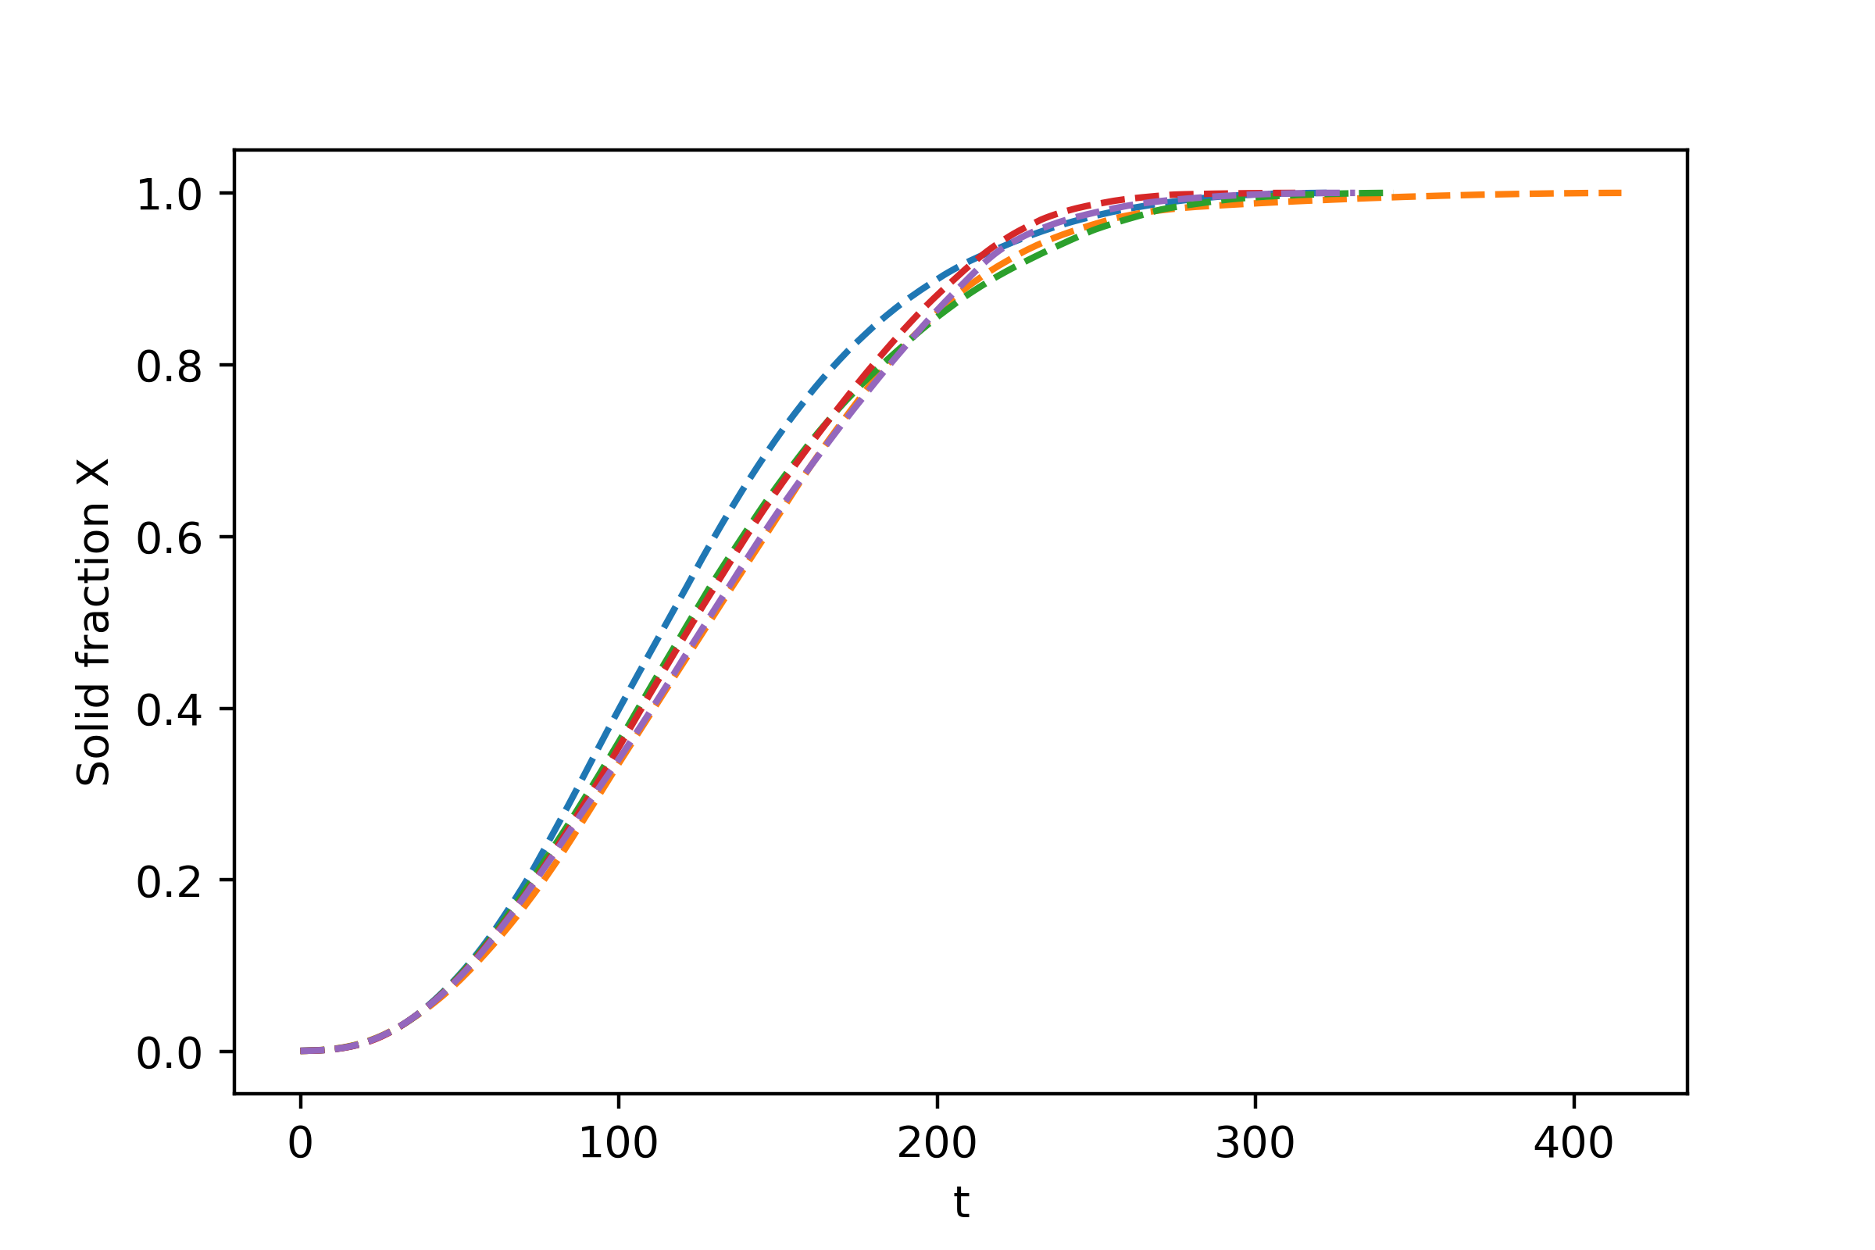
Total Energy, Volume Fraction, Particle Count and Avrami Plot for Five Runs with Different RNG Seeds
Initial nuclei only: n=d
33
Notes:
Average slope = 2.27

Slide 9
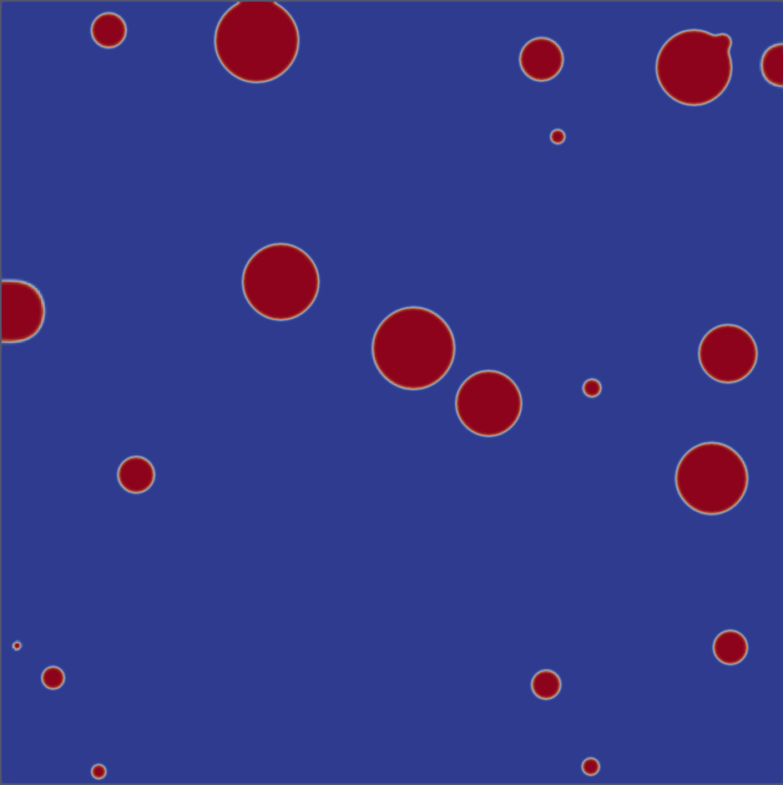
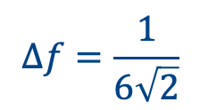
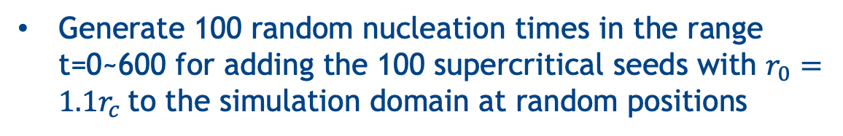
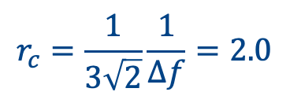
3. Explicit Nucleation: Multiple Seeds at Random Times
$$∆f=\frac{1}{6\sqrt{2}}$$
$$r_{c}=\frac{1}{3\sqrt{2}}\frac{1}{∆f}=2.0$$
System size: 1000 x 1000
No-flux boundary condition
t=100
Generate 100 random nucleation times in the range t=0~600 for adding the 100 supercritical seeds with $r_{0}={1.1r}_{c}$to the simulation domain at random positions
Run the simulation until t = 600. By this time, the whole domain should be transformed to solid
Plot the time evolution of the total free energy, the total number of particles, the volume fraction, and make the Avrami plot. The slope of the Avrami plot should be close to n=3
26

Slide 10
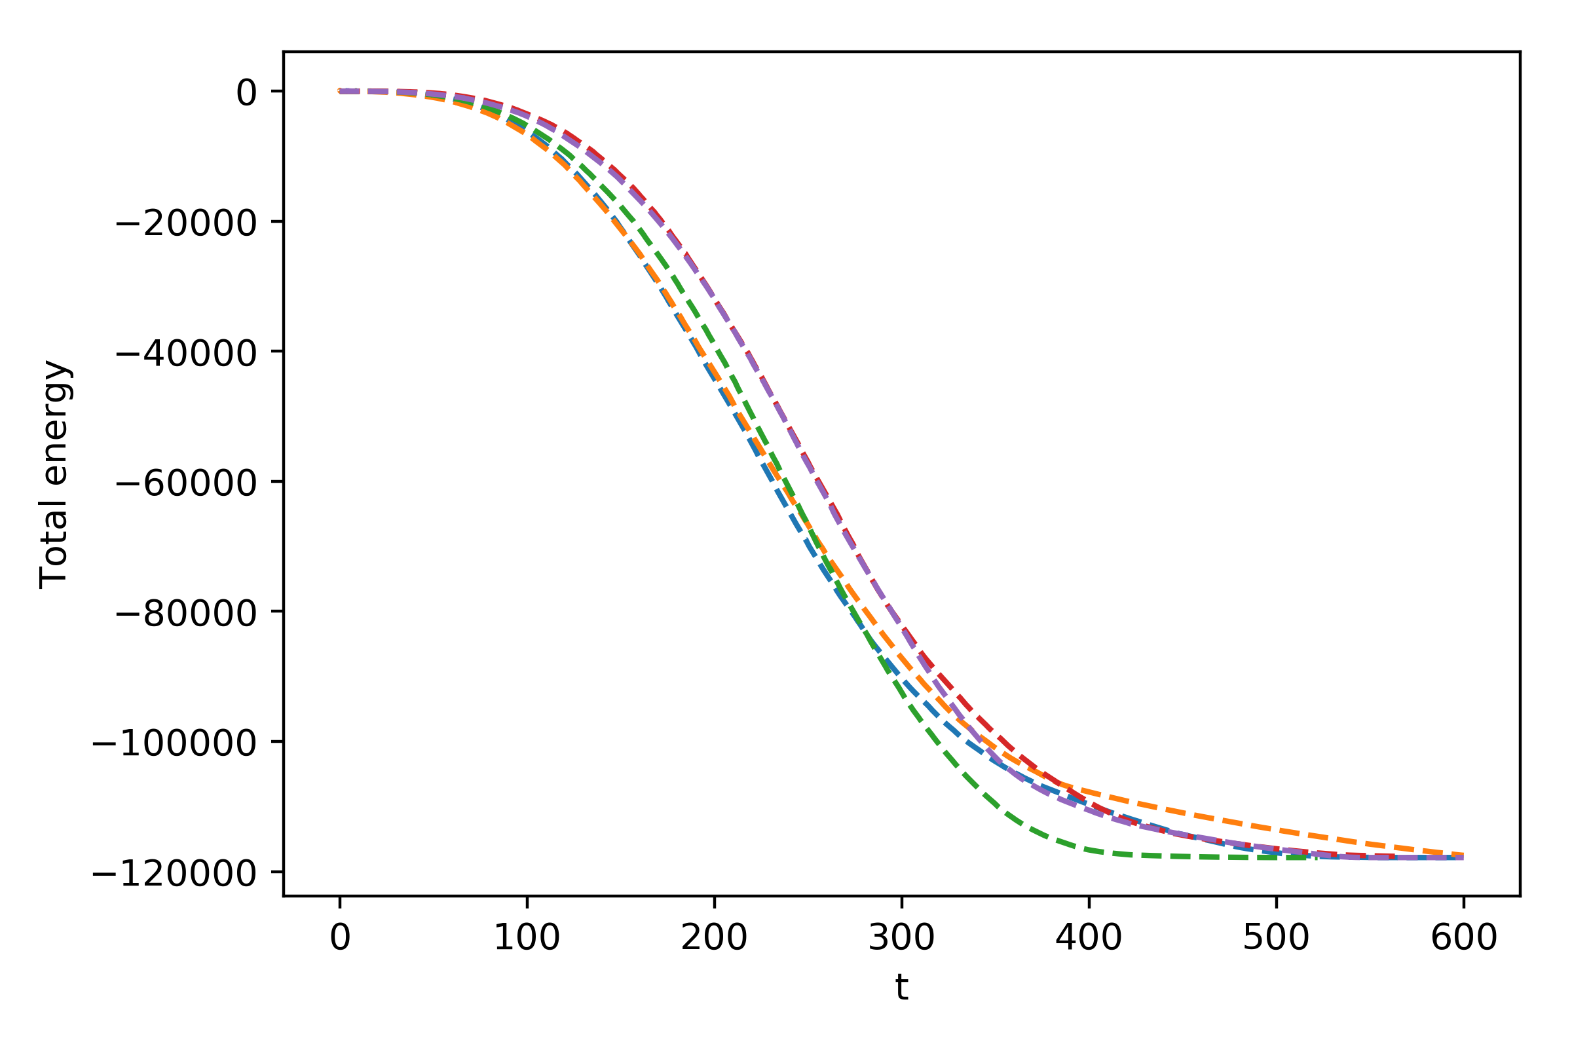
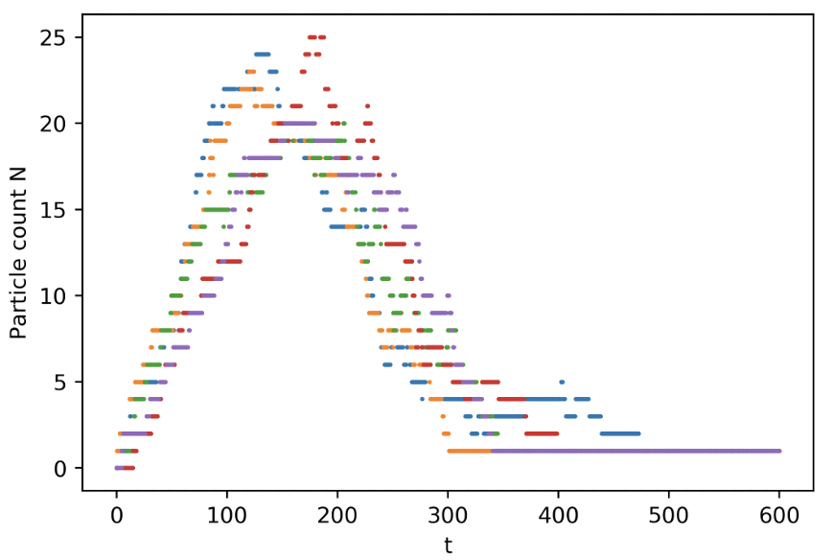
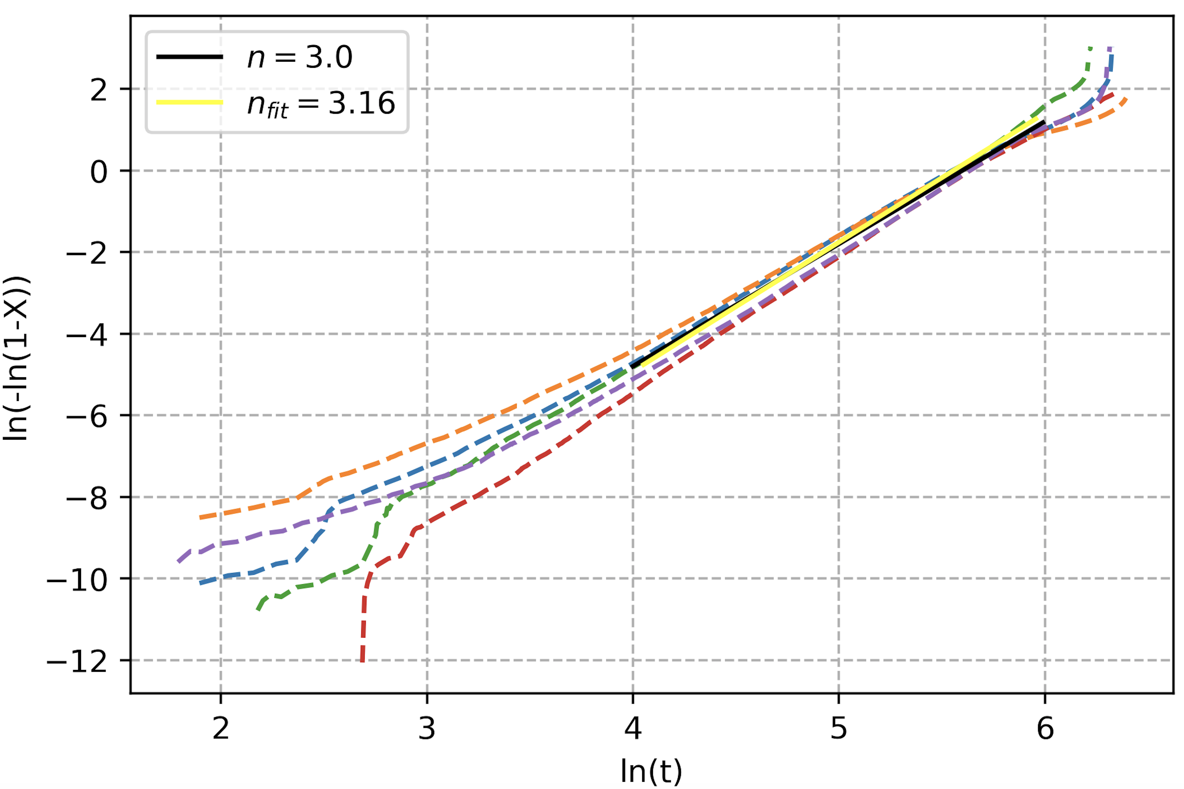
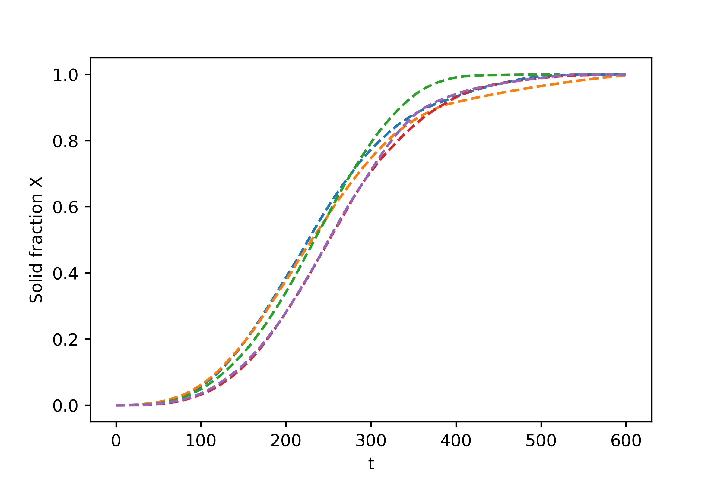
Total Energy, Volume Fraction, Particle Count and Avrami Plot for Five Runs with Different RNG Seeds
Constant nucleation rate: n=d+1
33
Notes:
Average slope = 3.00

Slide 11
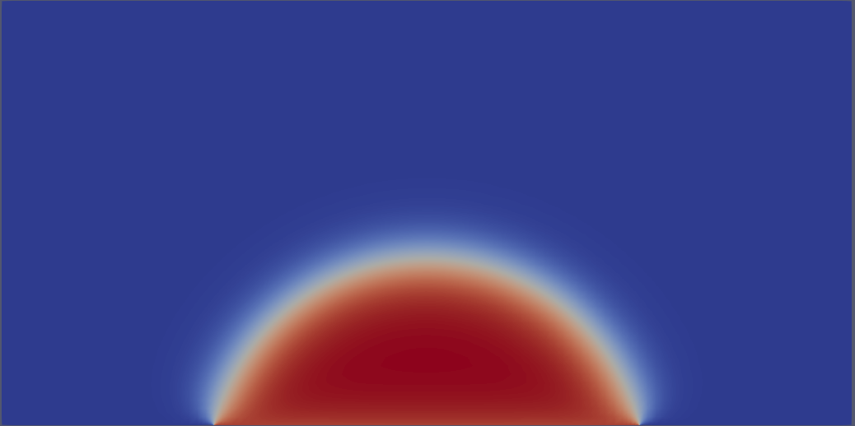
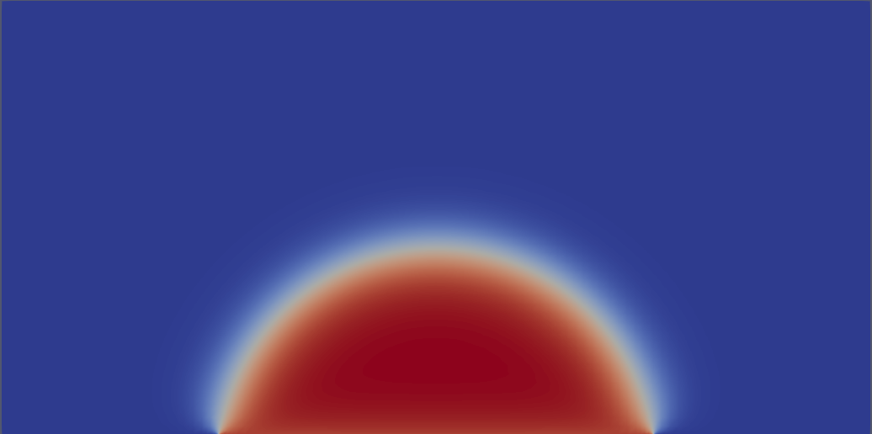
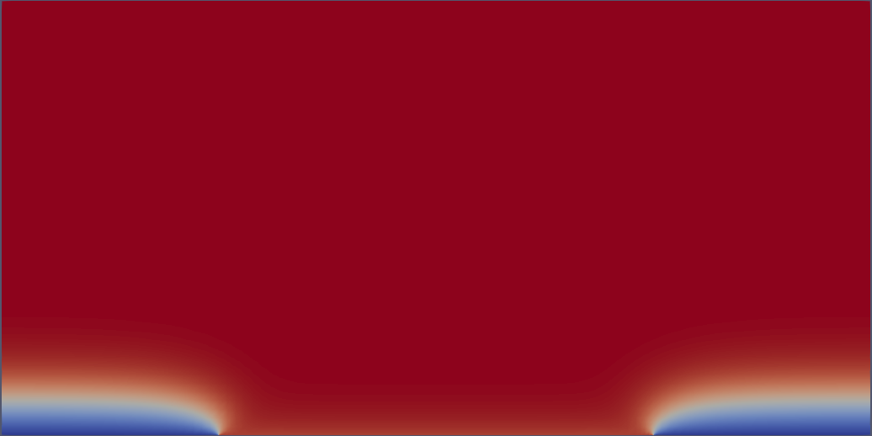
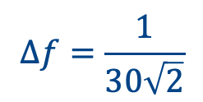
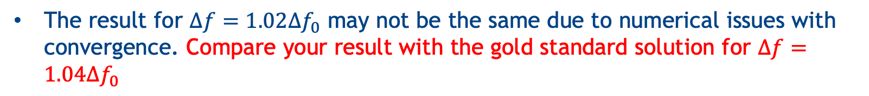
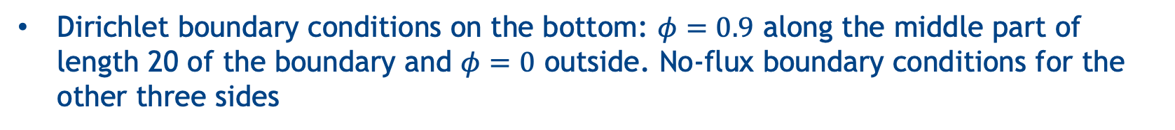
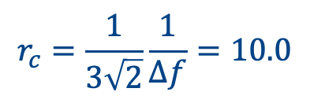
4. Athermal Nucleation
$$∆f=\frac{1}{30\sqrt{2}}$$
$$r_{c}=\frac{1}{3\sqrt{2}}\frac{1}{∆f}=10.0$$
System size: 40 x 20
Dirichlet boundary conditions on the bottom: $φ=0.9$ along the middle part of length 20 of the boundary and $φ=0$ outside. No-flux boundary conditions for the other three sides
Run four simulations with different driving force:$∆f=0.98{∆f}_{0},1.00{∆f}_{0},1.02{∆f}_{0}, 1.04{∆f}_{0}$
Run the simulation until t=6500, and plot the solid fraction X. Show the snapshot of the phase-field at t=6500
The result for $∆f=1.02{∆f}_{0}$ may not be the same due to numerical issues with convergence. Compare your result with the gold standard solution for $∆f=1.04{∆f}_{0}$
27

Slide 12
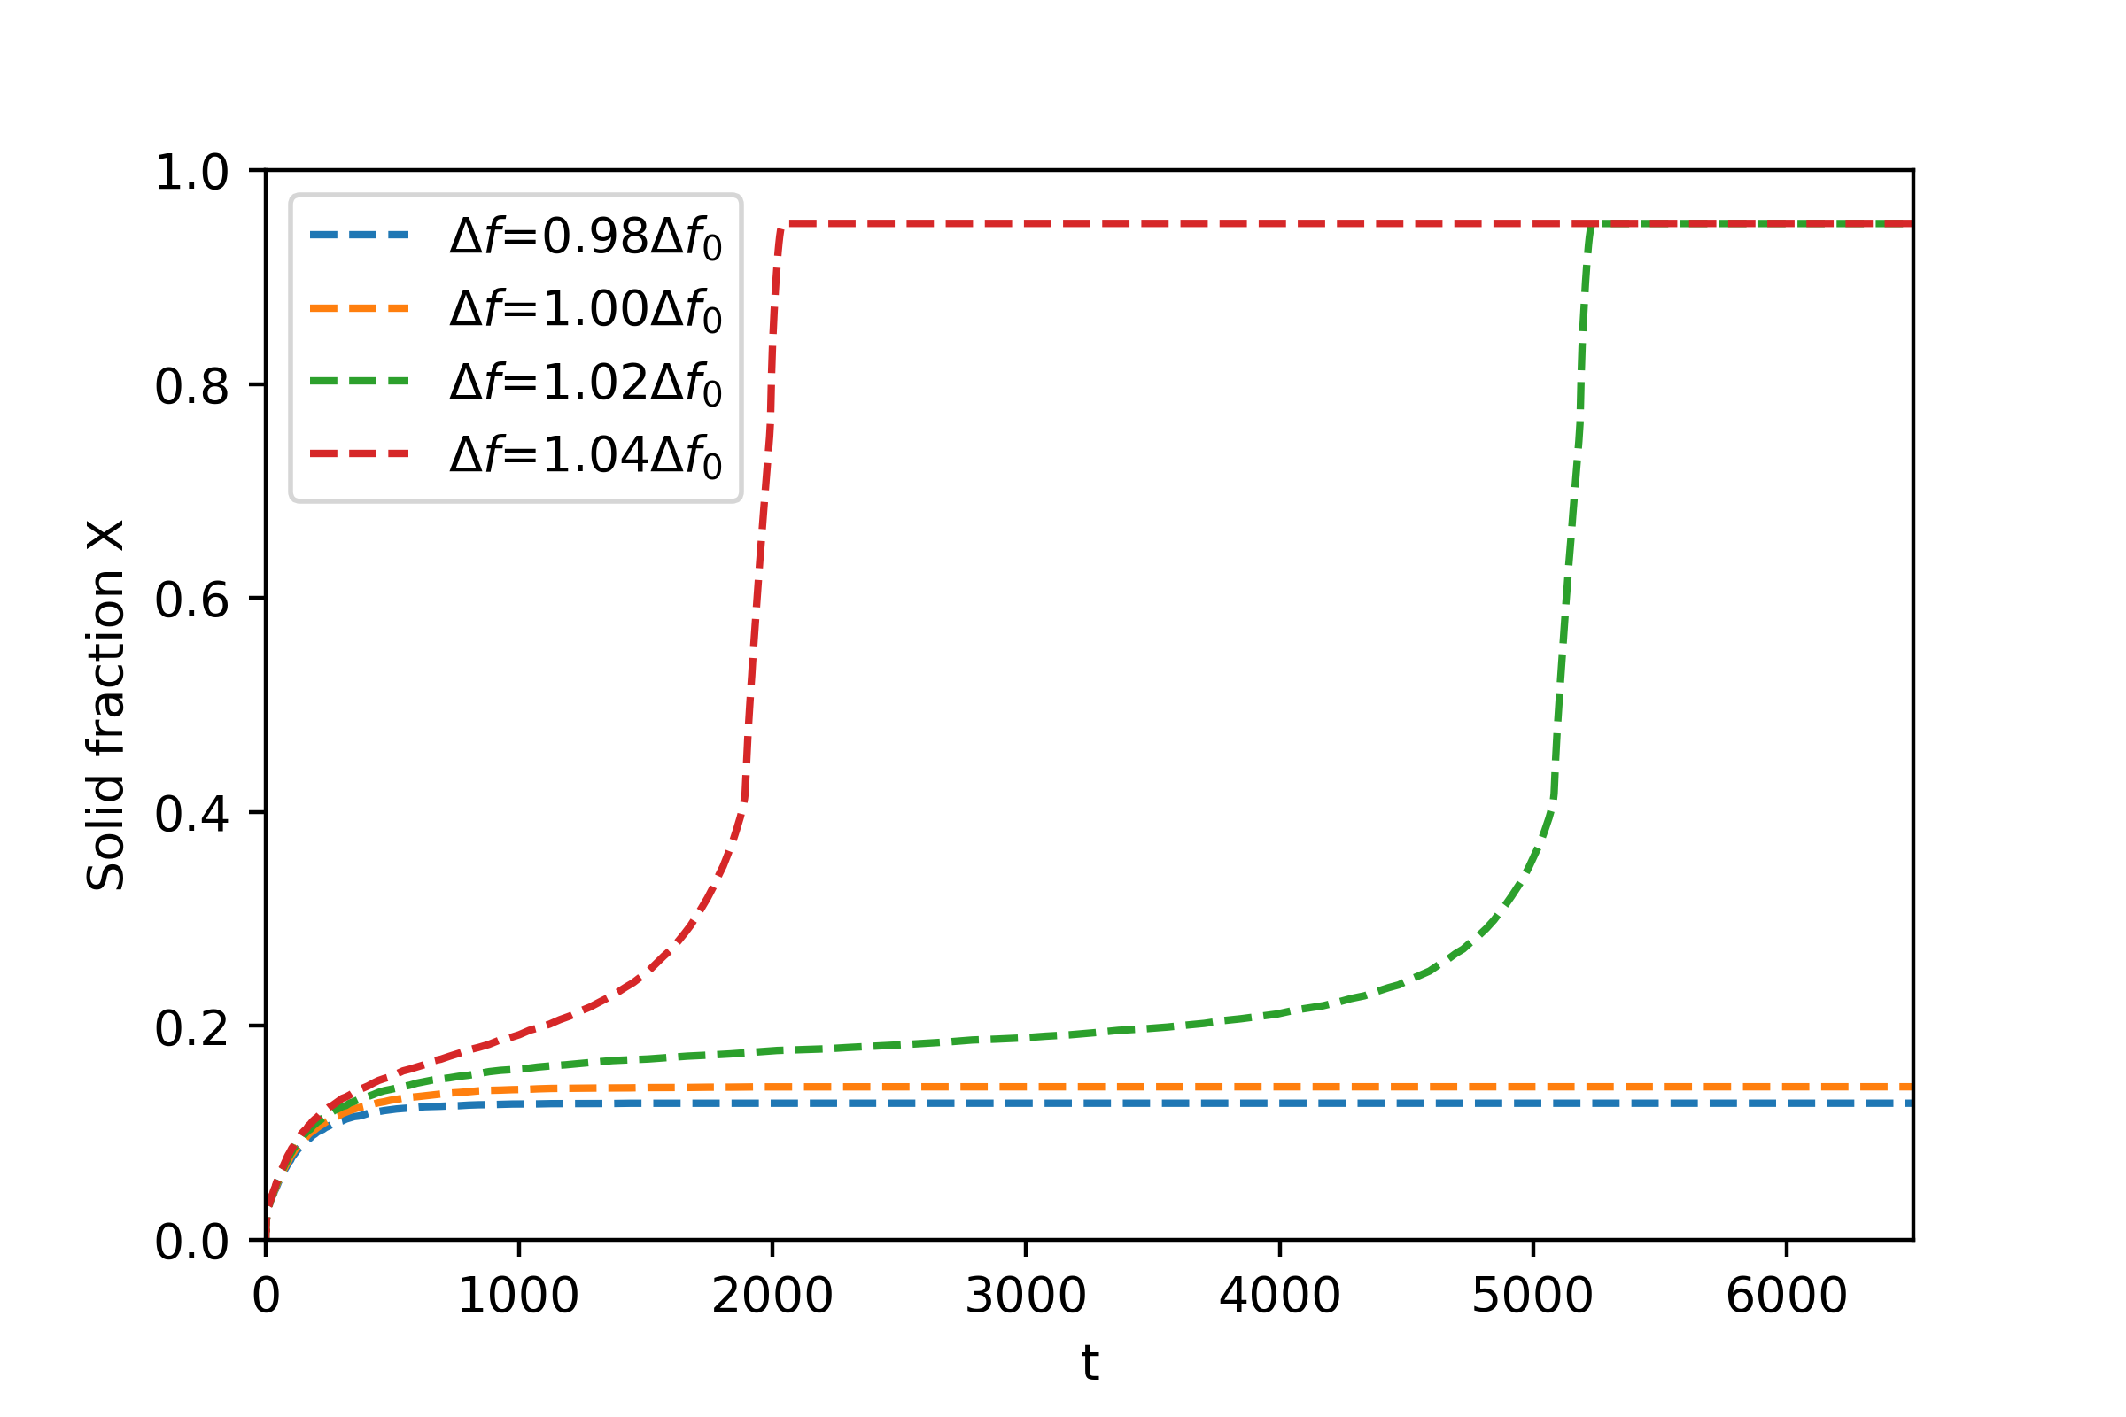
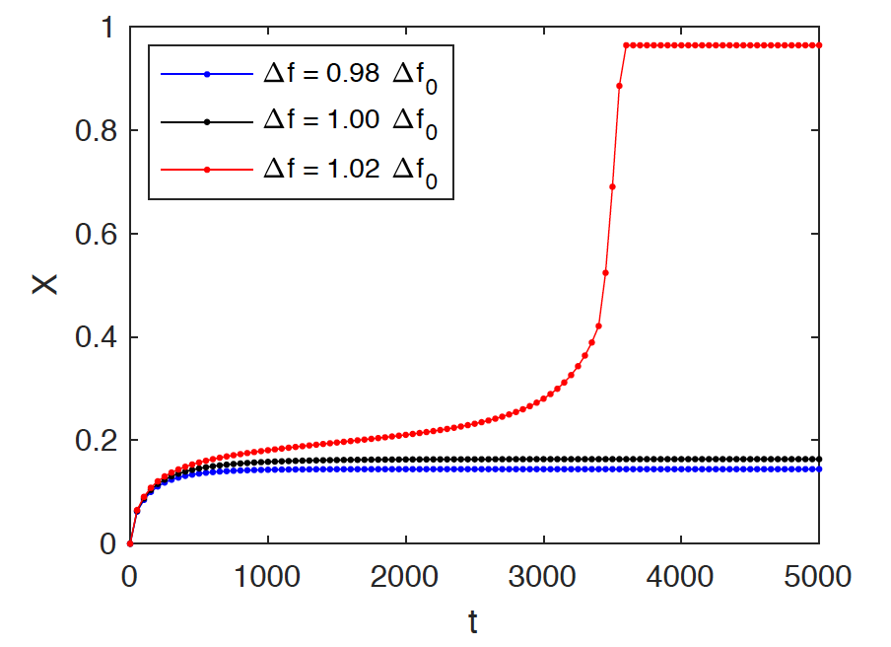




Solid Fraction
Adaptive meshing:
MOOSE
$∆x=0.2$at the interface
Finite Difference
Adaptive time stepper:
$∆t=0.01$ from the beginning
FiPy
PRISMS-PF
X
21
t

Slide 13


Convergence Test for Athermal Nucleation
(finest part Δx=0.025)
Gold standard solution
30

